Slide 1
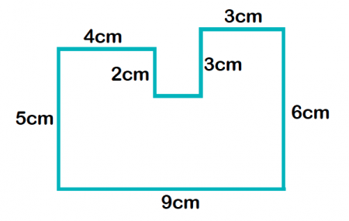
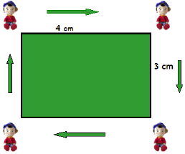
My Measurement Interactive Notebook
Name
Class:
Teacher:
Term 3 Semester 2

Slide 2
24
7
30
Area
Date
EQ – How we can use formulas to find areas of different shapes?

Slide 3
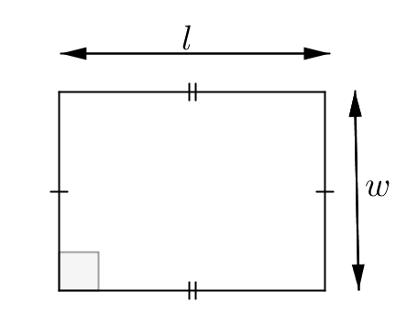
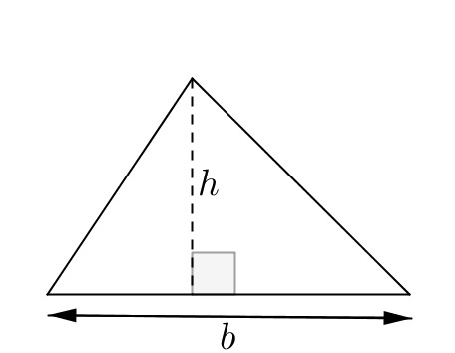
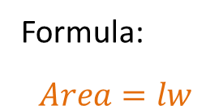
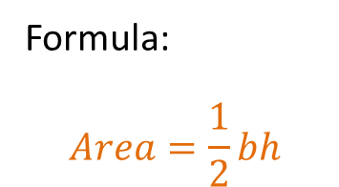
24
7
30
Area
Date
EQ – How we can use formulas to find areas of different shapes?
The area of a shape is the amount of space exists inside a 2 dimensional space. The 3 basic shapes are;
Area of a rectangle
Formula:
$$Area=lw$$
Formula:
$$Area=\frac{1}{2}bh$$
Area of a triangle

Slide 4
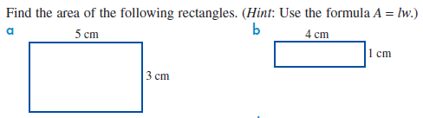
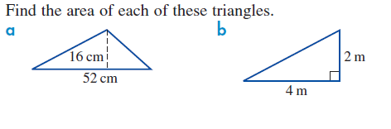
Examples
Let’s try together.

Slide 5
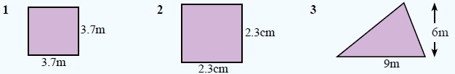

Your turn.

Slide 6
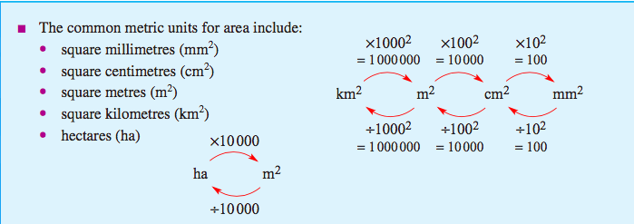
Remember your Conversion Caterpillar!

